Slide 1

Introduction to UniProt
ECCB September 2018
Andrew Nightingale

Slide 2
We Aim To Provide
‘The highest quality, most comprehensive and most thoroughly annotated protein resource’
Including:
Detailed information on protein function, interactions, pathways etc.
Sequences, including isoforms, disease variants and PTMs
Stable identifiers (accessions)
UniProt Releases every 4 weeks and is freely available http://www.uniprot.org/downloads
For Help, Contact us: help@uniprot.org, on twitter @uniprot or visit our YouTube Channel uniprotvideos

Slide 3
UniProt Team
PIs: Alan Bridge, Alex Bateman, Cathy Wu
Key staff: Cecilia Arighi (Curation), Darren Natale (Content), Hongzhan Huang (Development), Manuela Pruess (Coordination), Maria Martin (Development), Michele Magrane (Curation), Nicole Redaschi (Development), Peter McGarvey (Content), Sandra Orchard (Content), Shriya Raj (Coordination), Sylvain Poux (Curation)
Content/Curation: Alistair MacDougall, Andre Stutz, Andrea Auchincloss, Anne Estreicher, Anne Morgat, Arnaud Gos, C. R. Vinayaka, Catherine Rivoire, Chantal Hulo, Christian Sigrist, Cristina Casals Casas, Damien Lieberherr, Elena Speretta, Elisabeth Coudert, Emma Hatton-Ellis, Emmanuel Boutet, Florence Jungo, George Georghiou, Ghislaine Argoud-Puy, Guillaume Keller, Hema Bye-A-Jee, Ivo Pedruzzi, John S. Garavelli, Karen Ross, Kate Warner, Kati Laiho, Klemens Pichler, Kristian Axelsen, Lai-Su Yeh, Lionel Breuza, Livia Famiglietti, Lucila Aimo, Marc Feuermann, Michael Tognolli, Nadine Gruaz, Nevila Hyka-Nouspikel, Nidhi Tyagi, Patrick Masson, Penelope Garmiri, Philippe Lemercier, Qinghua Wang, Ramona Britto, Rossana Zaru, Sandrine Pilbout, Shyamala Sundaram, Ursula Hinz, Yvonne Lussi
Development: Alan Da Silva, Alexandr Ignatchenko, Andrew Nightingale, Arnaud Kerhornou, Beatrice Cuche, Benoit Bely, Borisas Bursteinas, Chuming Chen, Delphine Baratin, Dushyanth Jyothi, Edouard De Castro, Edward Turner, Elisabeth Gasteiger, Emanuele Alpi, Guoying Qi, Hermann Zellner, Jerven Bolleman, Jian Zhang, Jie Luo, Joseph Onwubiko, Leonardo Gonzales, Leslie Arminski, Leyla Garcia Castro, Mark Bingley, Mahdi Mahmoudy, Monica Pozzato, Parit Bansal, Preethi Vasudev, Rabie Saidi, Rizwan Ishtiaq, Sangya Pundir, Sebastien Gehant, Teresa Batista Neto, Thierry Lombardot, Tony Sawford, Tony Wardell, Tunca Dogan, Vicente Lara, Vishal Joshi, Vladimir Volynkin, Xavier Martin, Xavier Watkins, Yongxing Chen, Yuqi Wang
European Bioinformatics Institute (EMBL-EBI), Hinxton, Cambridge, UK
Protein Information Resource (PIR), Washington DC and Delaware, USA
SIB Swiss Institute of Bioinformatics (SIB), Geneva, Switzerland

Slide 4

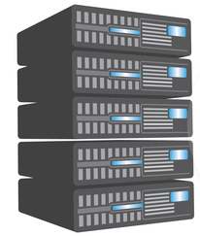
The two types of UniProtKB entries
UniProtKB- SwissProt
(Reviewed)
Manually curated
Non-redundant
1 Entry Per Protein
High-Quality
Roughly half million entries
UniProtKB- TrEMBL
(Unreviewed)
Automatically Annotated
Redundant
1 Entry Per nucleotide sequence
Computationally Generated
About 120 Million Entries
Notes:
Vamos a ver un poco más en detalle los dos subconjuntos de registros que tenemos en UniProt KB.
Los registros curados y los no curados
<DESCRIBIR>

Slide 5
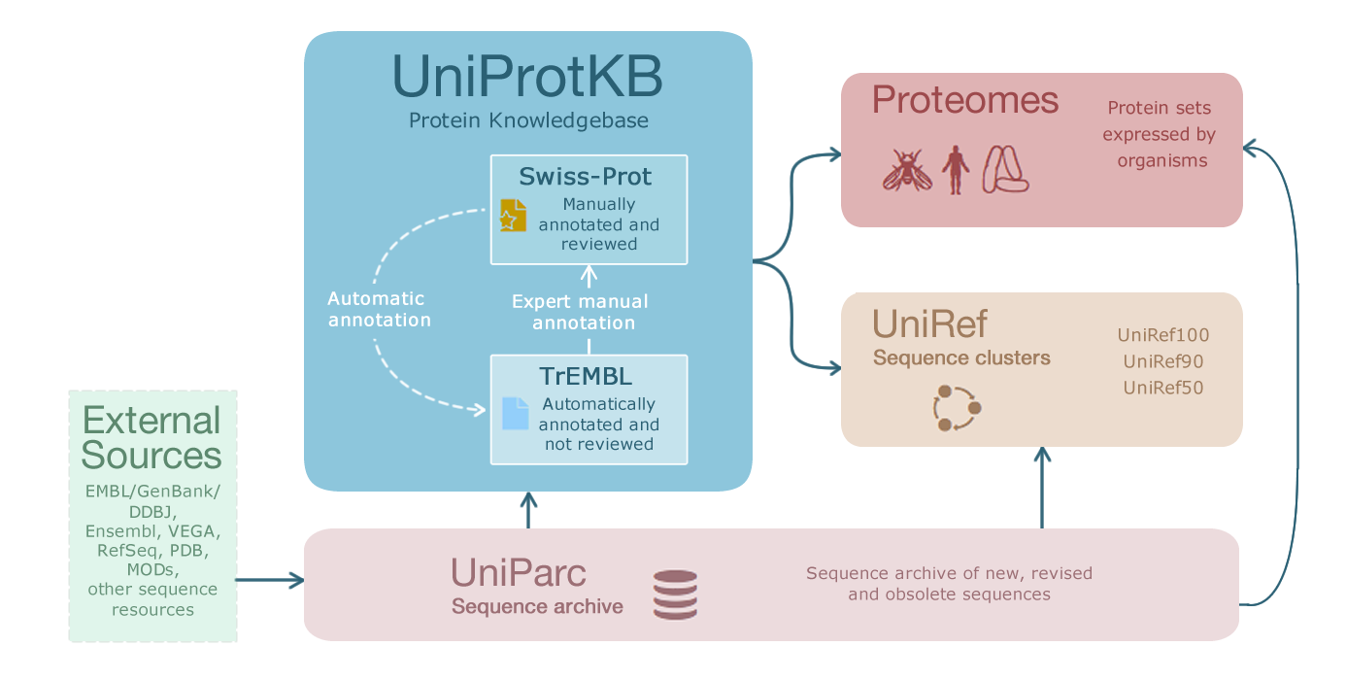
UniProt Resources
Programmatic Access

Slide 6
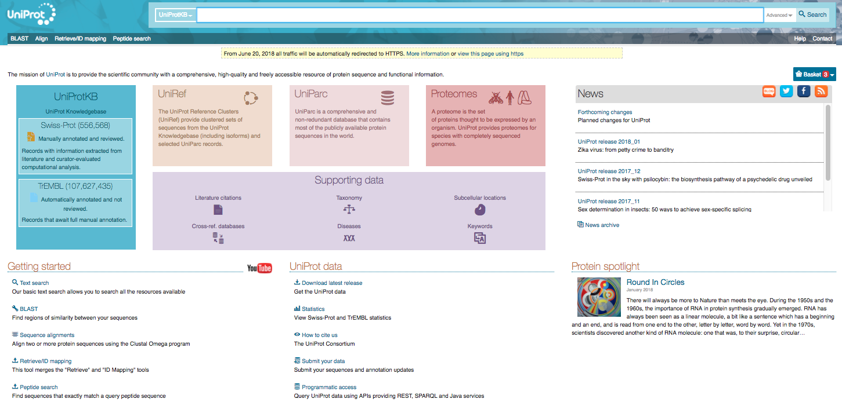
‘Google like’ search bar.
Advanced search option.
high quality expert curation
non-redundant (1 entry/gene/species)
cross-references in every entry
~0.55 million entries
expert-led automatic annotation
sequence redundancy allowed
computationally generated
cross-references in every entry
millions of entries

Slide 7





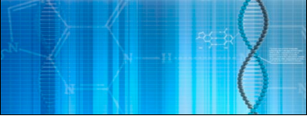



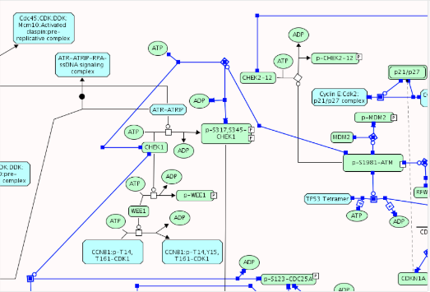

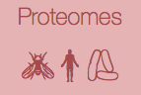
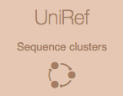



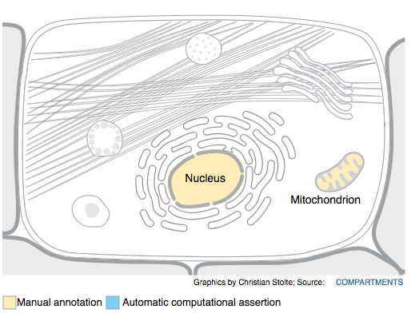







UniProt – the protein hub
UniProt Website Rest API
Sequences
Sequences
UniProt SPARQL API
Computational Services
Computational Services
RefSeq
Variation/
Mutagenesis
Functional Annotation
Functional Annotation
Systems Biology
Systems Biology

Slide 8
UniProt Resources
Programmatic Access

Slide 9
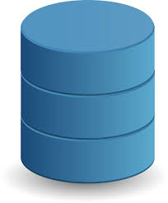

Sequence data flow into UniProtKB
UniProtKB
PDB
Reviewed
(Swiss-Prot)
Ensembl
annotation
submission
UniParc
nucleotide seqs
(large/small scale )
Unreviewed (TrEMBL)
ENA

Slide 10
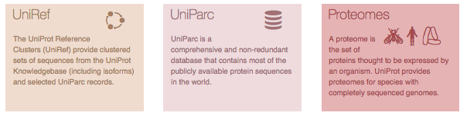
Additional Sequence Data
UniRef100 identical sequences and sub-fragments with 11 or more residues.
UniRef90 fromUniRef100 sequences, each sequence has at least 90% sequence identity to, and 80% overlap with, the longest sequence.
UniRef50 from UniRef90 with at least 50% sequence identity to, and 80% overlap with, the longest sequence in the cluster.
UniParc is a comprehensive and non-redundant database that contains most of the publicly available protein sequences in the world.
UniProt provides proteomes for species with completely sequenced genomes.
Some proteomes are manually or algorithmically selected as reference proteomes; as they are model organisms or organisms of interest for biomedical research and phylogeny.
Redundant proteomes can be retrieved via UniParc.

Slide 11
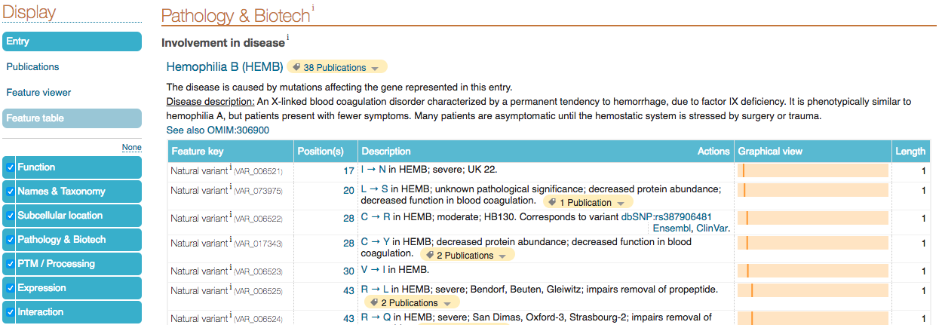
Sequence Variants
Majority of variants associated to a disease.
Variant database cross-references provided.
Human have a UniProt identifier
Additional information about variant provided in description
Protein position and change stated

Slide 12
UniProt – the protein hub
Sequences
Computational Services
RefSeq
Variation/
Mutagenesis
Functional Annotation
Systems Biology

Slide 13
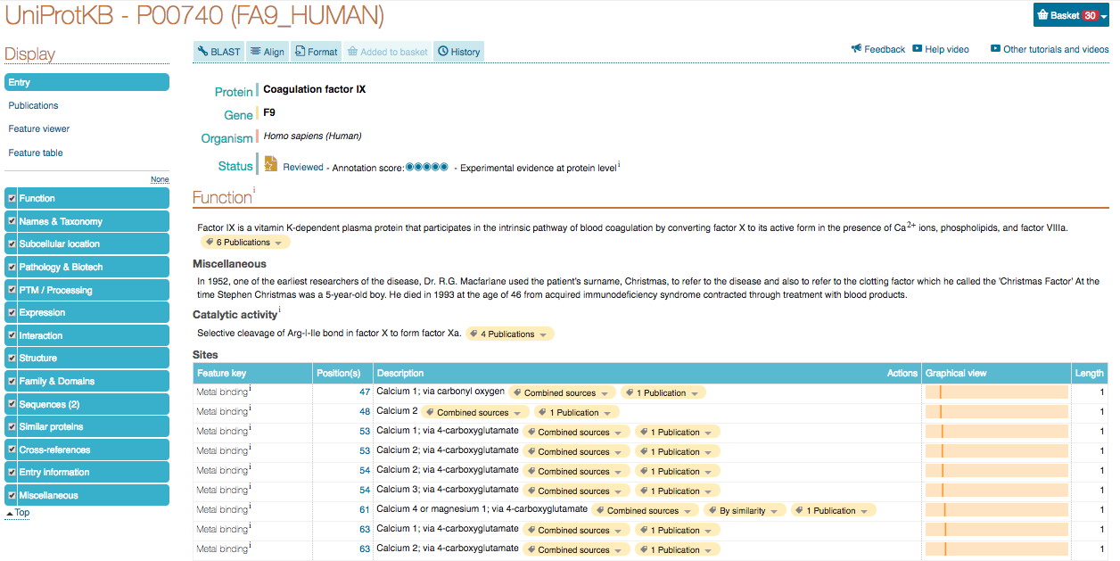
A UniProt Protein Entry

Slide 14
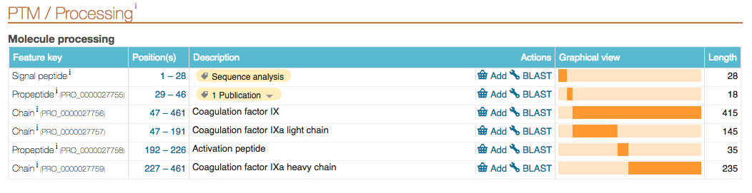
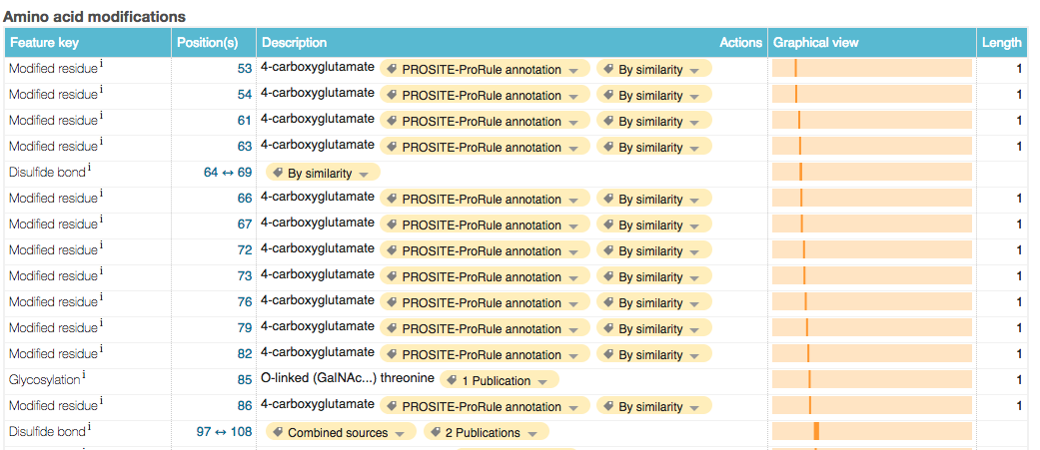

Slide 15
UniProt – the protein hub
Sequences
Computational Services
RefSeq
Variation/
Mutagenesis
Functional Annotation
Systems Biology

Slide 16
A UniProt Protein Entry

Slide 17
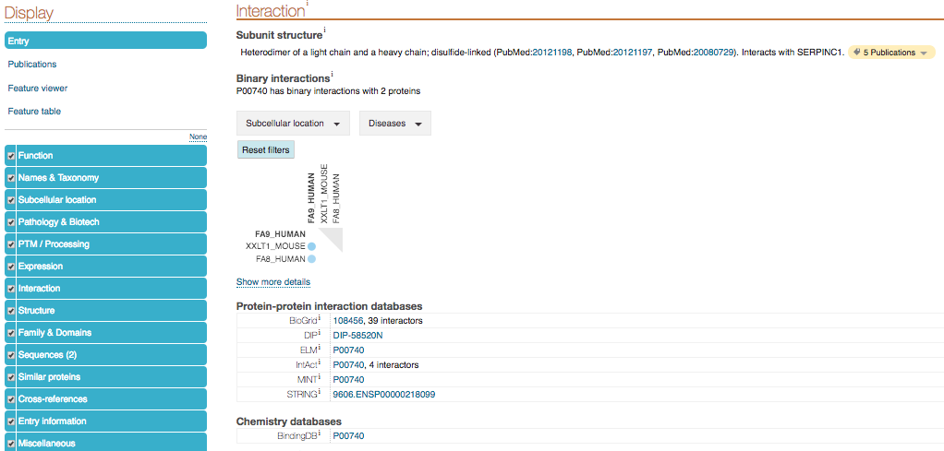
UniProt Interaction Annotations

Slide 18
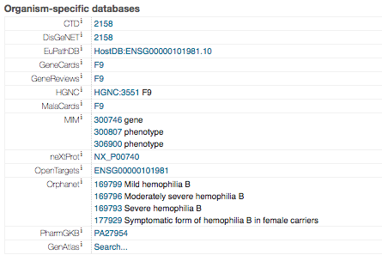
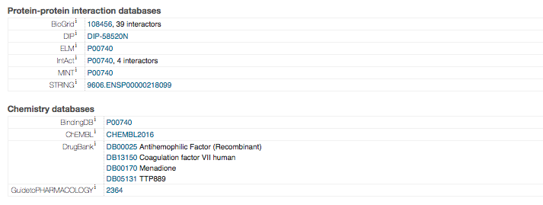
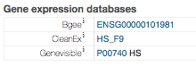
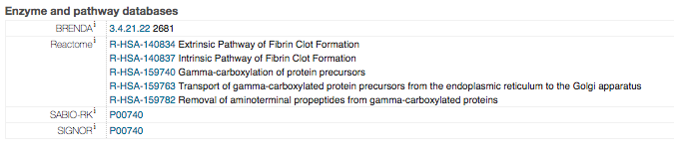
UniProt Cross-references

Slide 19
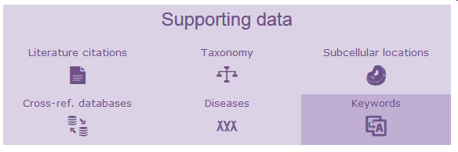
Supporting data
can be searched separately
link to relevant UniProtKB entries

Slide 20
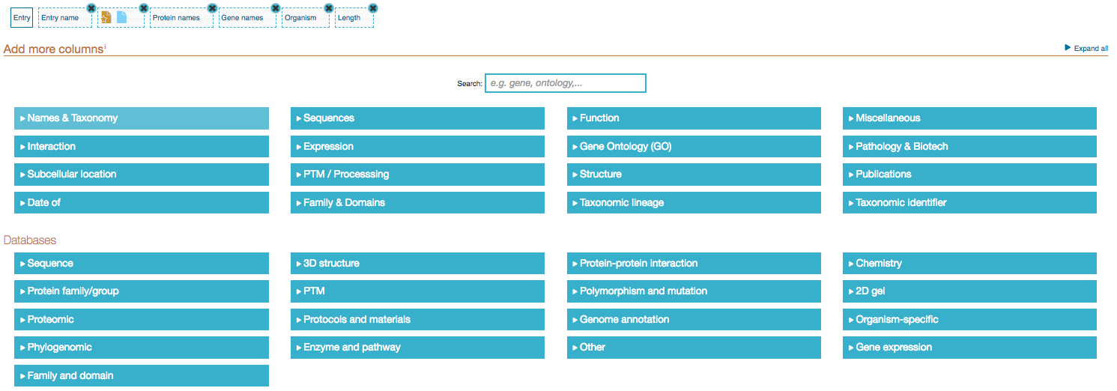
UniProtKB as a hub for Protein Information
~ 160 altogether functional annotations or cross-references

Slide 21
UniProt – the protein hub
UniProt Website Rest API
Sequences
UniProt SPARQL API
Computational Services
RefSeq
Variation/
Mutagenesis
Functional Annotation
Systems Biology

Slide 22
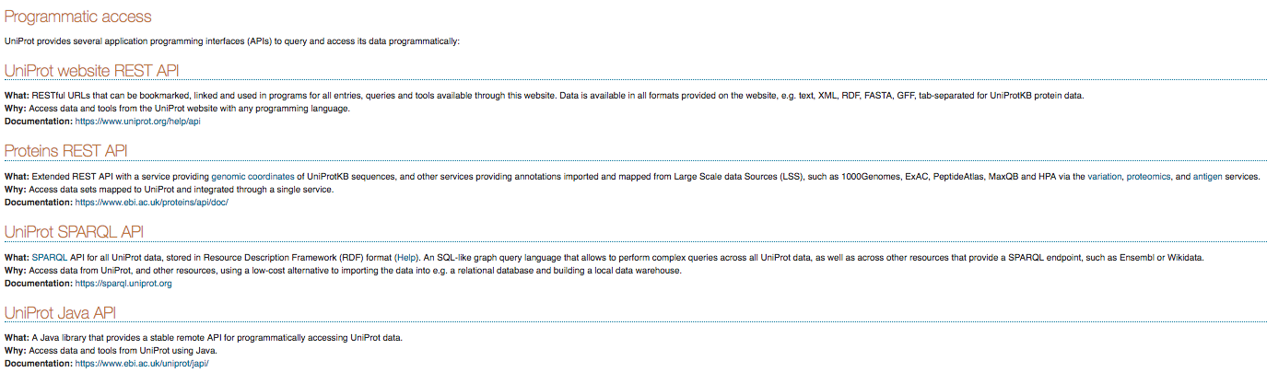
UniProt Programmatic Access
https://www.uniprot.org/help/programmatic_access

Slide 23






Acknowledgements
All UniProt Consortium members
Databases with which we interact
Funders

Slide 24
Thanks for your attention

Slide 25
Questions and Exercises I

Slide 26
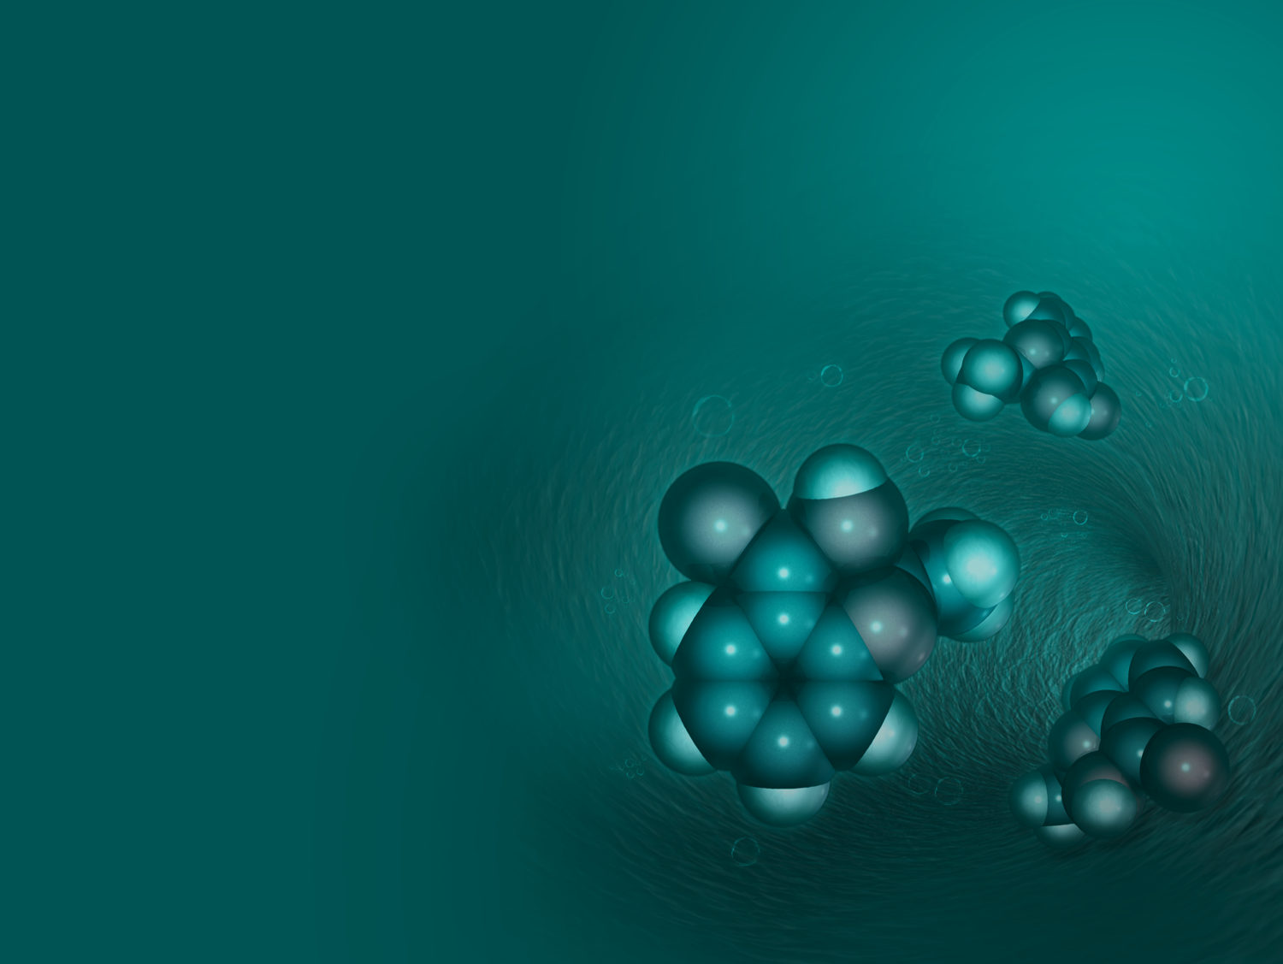
Accessing UniProt Data
UniProt Releases every 4 weeks and is freely available
http://www.uniprot.org/downloads
Provided in a range of formats: text, XML, XML/RDF, FASTA, GFF, tab-delimited
Web site
Supports simple and complex queries
Support programmatically for: Perl, Python, Ruby, and Java
Documentation and Details at: http://uniprot.org/help/programmatic_access
Online training: http://www.ebi.ac.uk/training/online/course/uniprot-exploring-protein-sequence-and-functional
Contact us and follow us
help@uniprot.org
UniProt Blog: http://insideuniprot.blogspot.co.uk
UniProt YouTube channel: https://www.youtube.com/user/uniprotvideos
UniProt Twitter: https://twitter.com/uniprot
UniProt Facebook page: https://www.facebook.com/uniprot.org

Slide 27
UniProt – the protein hub
UniProt Website Rest API
Sequences
UniProt SPARQL API
Computational Services
RefSeq
Variation/
Mutagenesis
Functional Annotation
Systems Biology

Slide 28
A UniProt Protein Entry

